Slide 1
Spain´s online gambling market: a brief overview in key figures
Juan Espinosa
DG for Gambling Regulation

Slide 2
State-wide online gambling market in Spain. Evolution
Interannual growth rate (%)
GGR (M€)

Slide 3
Spain online gambling active players
Total: 1.303.513
+ 7 %
Total: 1.394.949

Slide 4
Online gambling in Spain: channelisation estimations
*Data: H2GC

Slide 5
International Online gambling offshore/onshore estimations (2018)

Slide 6
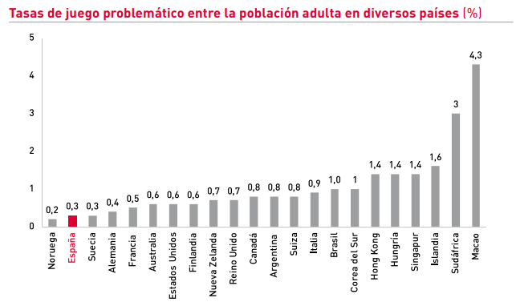
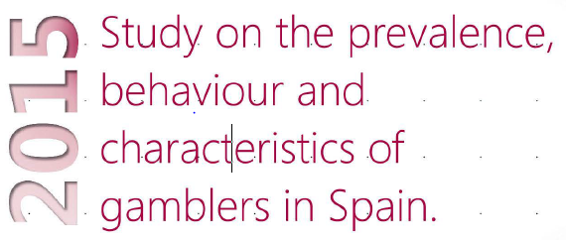
Prevalence of problem gambling: 2015 (source: DGOJ)

Slide 7
Prevalence of problem gambling: 2018 (source: Ministry of Health)

Slide 8
Access to gambling by minors (source: Ministry of Health)

Slide 9
Access to gambling by minors. International comparision
Source: ESPAD 2015

Slide 10
Gambling taxation in Spain: International Comparison on gambling spend
Spain
France
Denmark

Slide 11
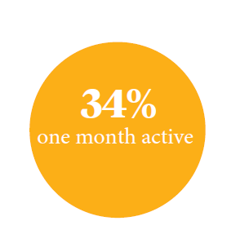
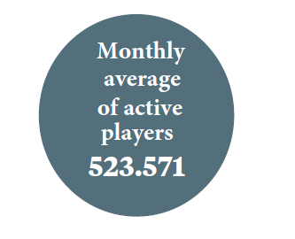
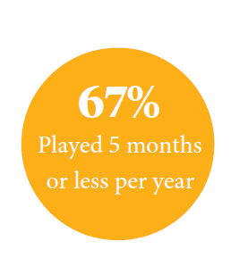
Spain’s online player profile 2017

Slide 12
Prevalence of gambling (source: Ministry of Health)

Slide 13
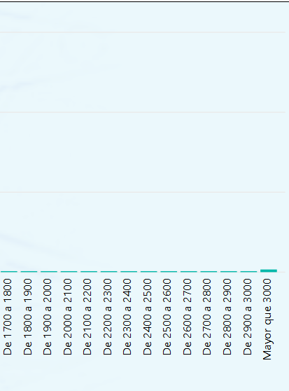
Spain’s online player profile 2017
← Losses: Gains→

Slide 14
Spain’s online player profile 2017

Slide 15
Thank you

